Slide 1

Iron Legion Inc. Tactical Drone Solutions for Police
George Le, Peter Maitland

Slide 2
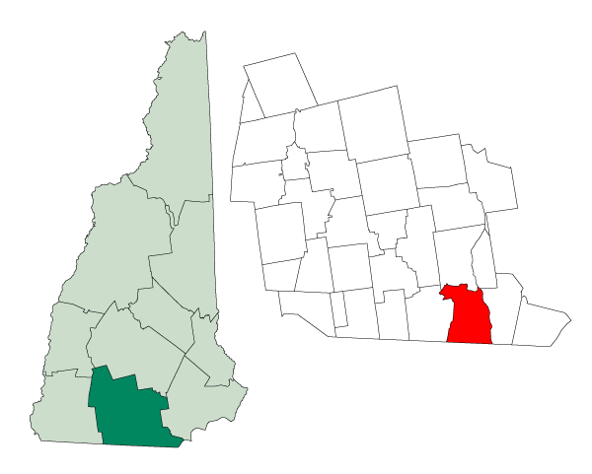
Partnering with Nashua Police Department

Slide 3
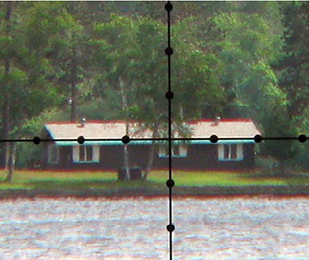
Problem – Lack of Situational Awareness
?
?
?

Slide 4
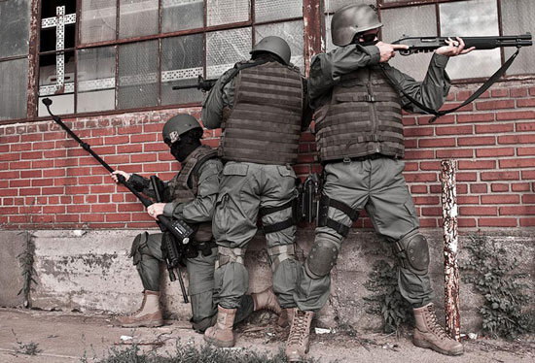
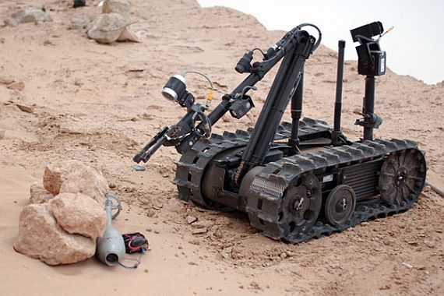
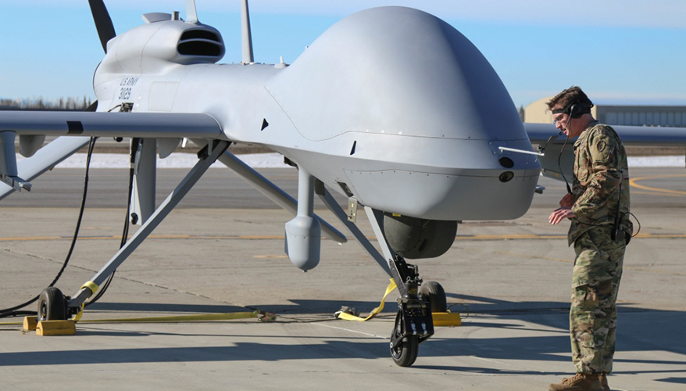
Current Methods – Unsafe and Costly
GET CLOSER? Endanger Officers and/or are Costly
Air solutions: limited by pricing and training
However, we can make it work!

Slide 5
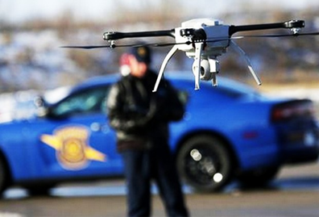
Solution – Help Police Get and Use Aerial Drones
Adapts off the shelf drones for SWAT purposes.
Trains officers on usage of the drones.
Services and upgrades the drone system over time.

Slide 6
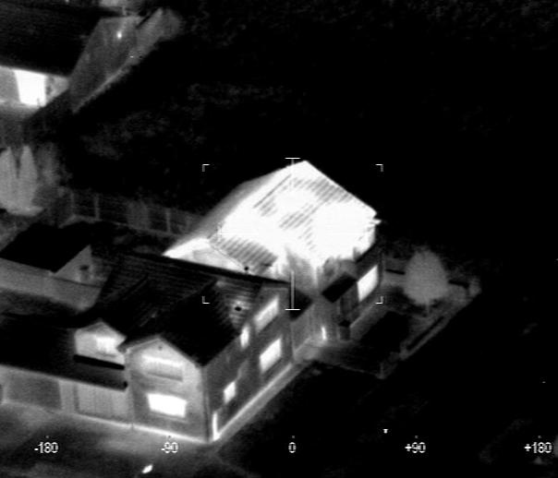
This is what we can provide!
Easy pinpointing of suspects

Slide 7
Market Opportunity
Firm PWC Estimate: $127B drone services industries
Security: $10B market
Police Department Private Support in New England: $1M market
This can AFFECT anyone at any time!

Slide 8
Business Model – Drones as a Service (DaaS)
Tiered Service Packages Listed in Appendix A

Slide 9
Needed Assistance – Advice and Capital
Advice and Guidance – Warm Introductions
Introductions to police departments with local or regional SWAT teams.
Contact with drone manufacturer to partner with.
Resources - $7000 in initial funding
Details in Appendix B

Slide 10
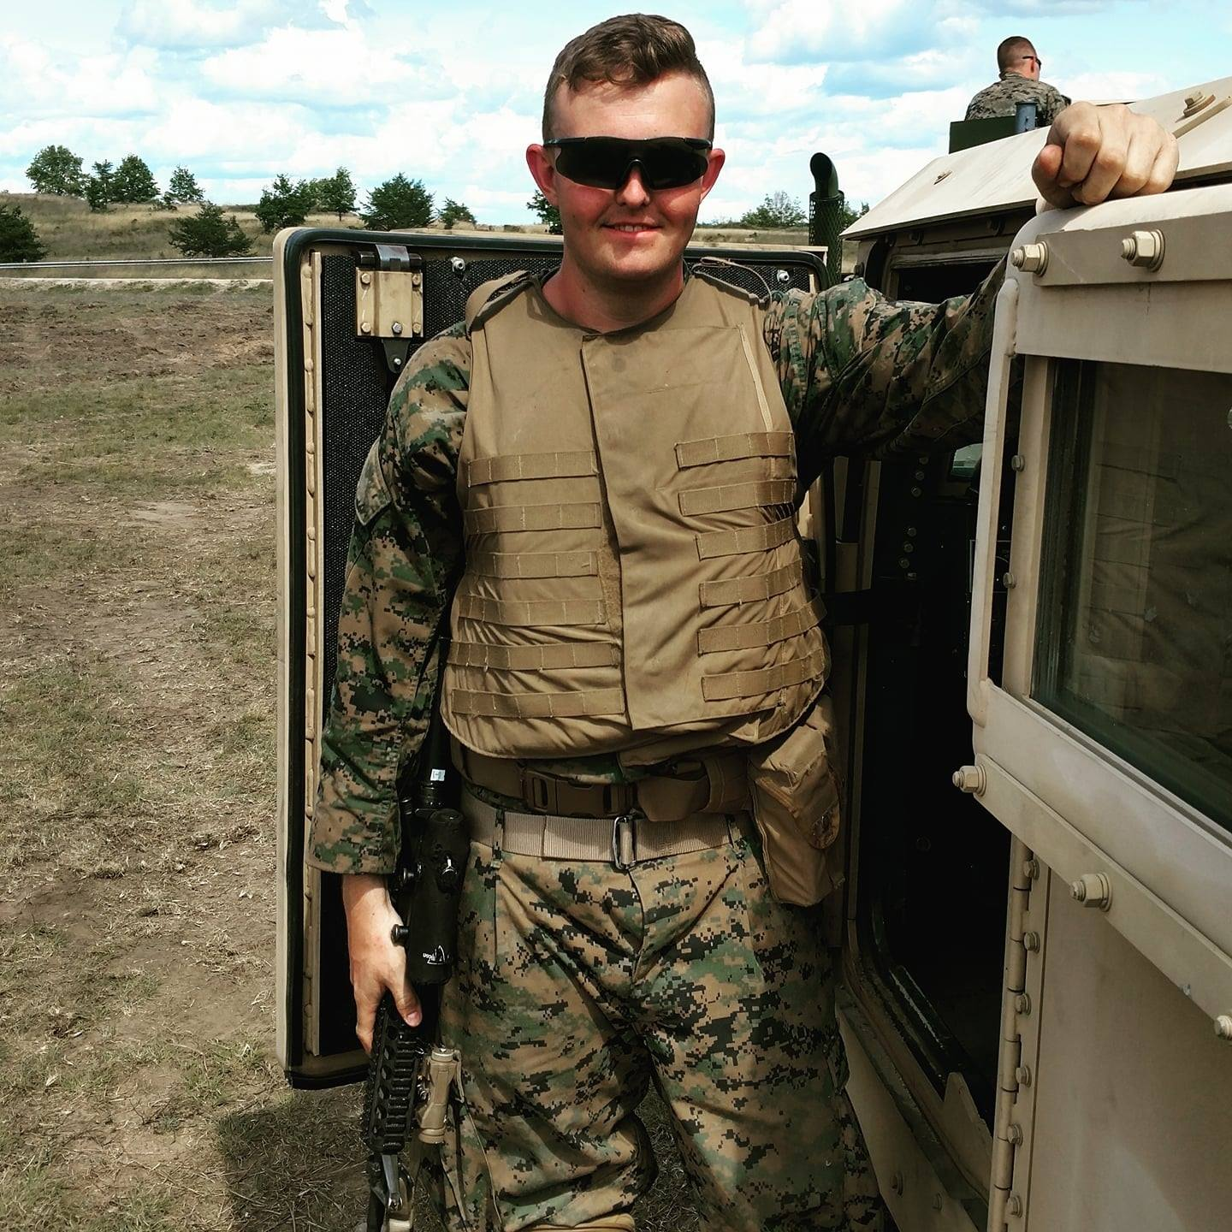

Student-Led Team from UMass Lowell
George Le
Co-founder/CEO
Technology, Training, and Administration
Peter Maitland
Co-founder/COO
Curriculum, Outreach, Operations

Slide 11

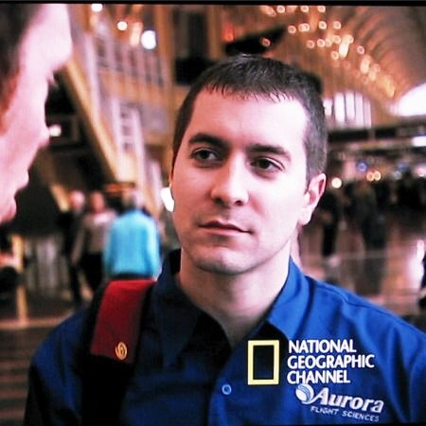
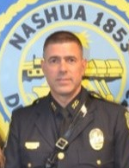

Board of Mentors
Boris Lipchin
Co-founder/CEO Brio System
Justin McClellan
Co-founder/CFO GreenSight Argonomics
Officer John Yurcak
Nashua Police Sergeant, UML Professor
Matthew Jakubowski
Founder Elephant Technology

Slide 12

Join the Legion! Looking for Mentors in the “-aaS” space
Iron Legion Inc. Tactical Drone Solutions for Police

Slide 13
Questions? Answers @ www.ironlegion.info
WHY?
This business is important to us because:
Police departments NEED the best modern tools to
ensure public safety and the safety of each individual officer.

Slide 14
Appendix A: Pricing
Tier 3 - $500 one time fee
Takes into account police department’s available budget and finds a drone solution for them. Minimum $2000 budgets (not including fee) to procure drones.
$250+ per event – Lease/Retainer on reserve fleet of drones
Tier 2 - $3000 per year:
All of the benefits of Tier 3
$1000 - Maintenance and service contract for one year.
$2000 - Training for individual officers to receive part 107 FAA license
Tier 1 - $10,000+ per year – Negotiable:
All of the benefits of Tier 2
$2500 per event – Event security, planning, request for additional pilots
$1000 – Tailored training for individual police departments.
Mix and Match - $5000 minimum
Grab what you like from each Tier and let’s make it work!

Slide 15
Appendix B: Budget for Year 2018
$3000 to procure a test drone (to adapt and demonstrate for SWAT teams( and an initial reserve drone.
$3000 to design, experiment, and develop a curriculum for tactical drone
~$200 for part 107 licenses for team-members
~$800 for website, promotion, marketing, travelling to conferences and misc. flex funds.
Looking to use some flex funds to prepare for seed round fundraising.

Slide 16
Appendix C: The Future!
More customer interviews!
Exploration into secure storage police footage for use as evidence.
Hired drone footage for training operations

